Slide 1



Exploring the Association Between Upheavals and Economic Sectors and GDP in Egypt

Slide 2
Introduction
Research Question and Hypothesis
Methodology
Sector-Specific Impact Analysis - Visualization
Sector Correlation Analysis
Hypothesis Testing
Results
Conclusion
Agenda

Slide 3

Introduction
Purpose of the Report: To analyze the impact of significant upheavals on Egypt's economy, focusing on specific economic sectors and overall GDP.
Events Analyzed: 2011 and 2013 Revolutions, and the 2020 COVID-19 Pandemic.
Importance of Study: This report aims to illuminate the relationship between different upheavals and Egypt's economic path.

Slide 4

Research Question and Hypothesis
Research Question
Hypothesis
There exists a statistically significant relationship between major upheavals and the economic performance in different sectors and GDP in Egypt.
Did significant political or global affect various economic sectors and GDP in Egypt?

Slide 5

Methodology
Data Collection: Data sourced from the Egyptian Ministry of Planning and Economic Development.
Data Cleaning: Steps taken to clean the data including outlier removal and handling missing values.
Data Analysis and Visualization: Descriptive statistics, observing trends and visual data representation.
Hypothesis Testing: Chi-squared test for hypothesis testing and p-value.

Slide 6
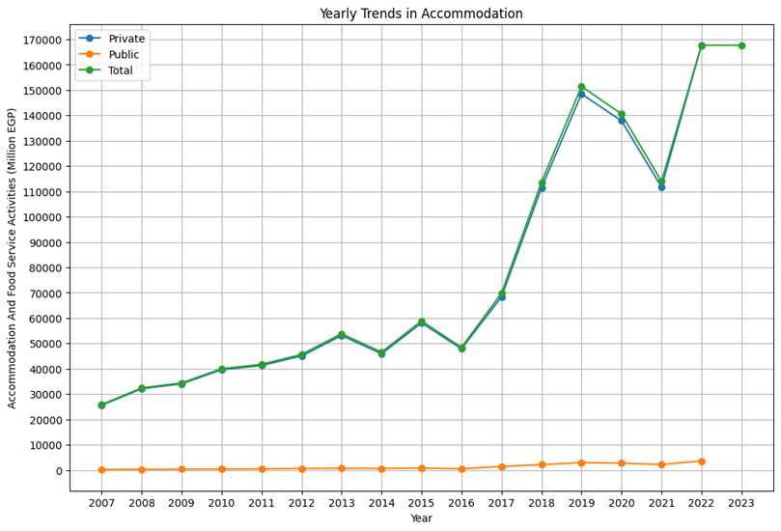
Sector-specific Impact Analysis
01. Accommodation and Tourism
During the 2011 Revolution, Egypt's tourism sector saw a 60% drop in revenues and a 16% decline in hotel occupancy, leading to a loss of about two billion U.S. dollars.
The 2020 pandemic further crippled the industry, with up to 80% booking cancellations and a projected 90% decline in internal tourism.

Slide 7
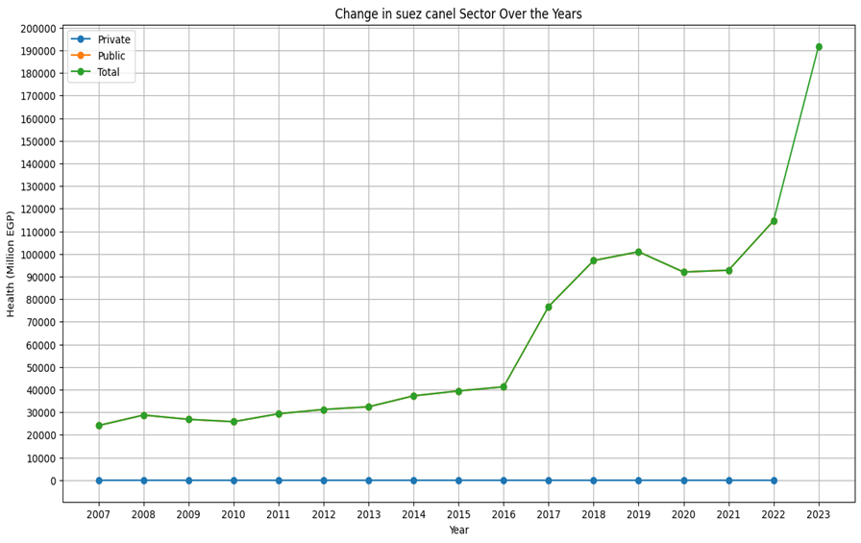
Sector-specific Impact Analysis
02. Suez Canal
The Suez Canal's traffic fluctuated, decreasing from 2008 to 2010, then stabilizing until 2016 when it surged due to a new canal extension. The 2020 pandemic caused a decline, and the 2021 blockage hindered growth, but traffic rebounded significantly by 2023.

Slide 8
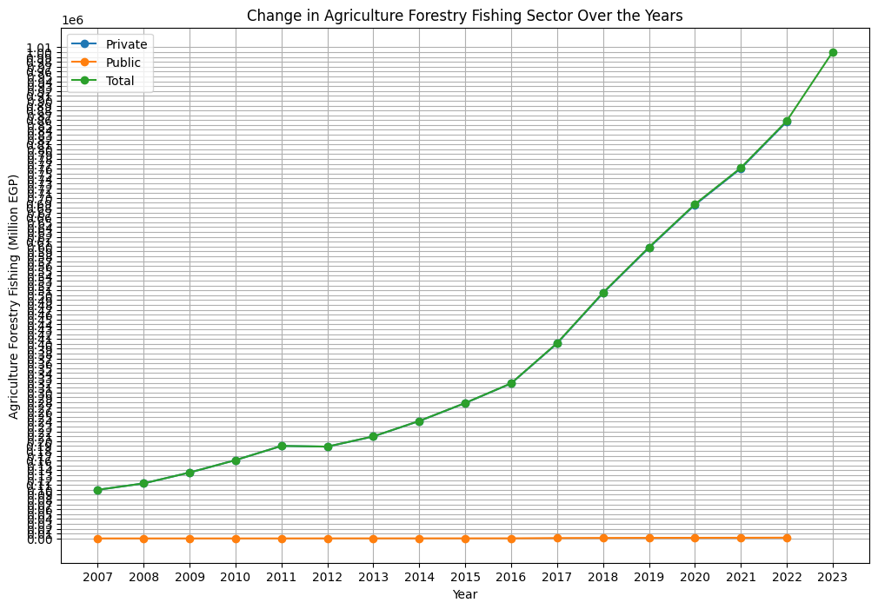
Sector-specific Impact Analysis
03. Agriculture
Expanding agricultural production during the COVID-19 crisis is a high priority for all governments around the world.
Therefore, there are usually no explicit restrictions for farmers, traders, and food markets.
Our model captures the potential indirect impact on agriculture that is likely to arise from reduced demand for food from hotels and restaurants.

Slide 9
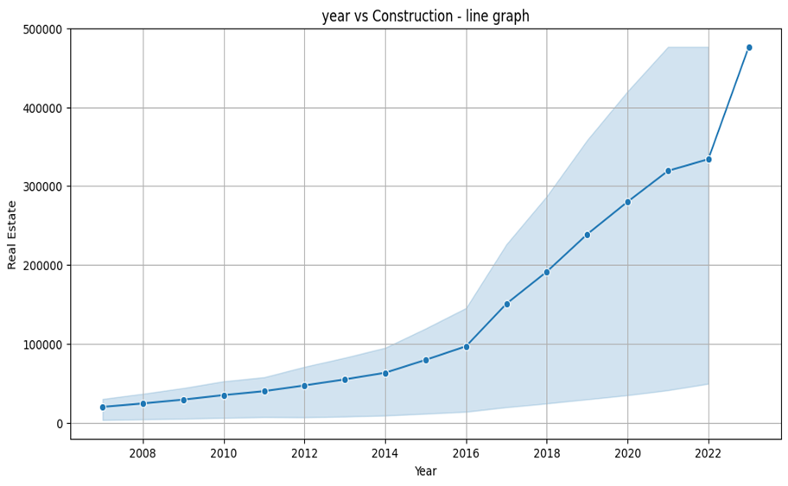
Sector-specific Impact Analysis
04. Construction
Construction activities continue in many places as the government balances the need to keep projects running while implementing precautionary measures, such as social distancing and lower numbers of workers on construction sites.
Relative to many manufacturing sub-sectors, we assume a smaller decrease in construction activity of 5 percent.
Figure : Construction Sector trends through the years in Egypt.

Slide 10
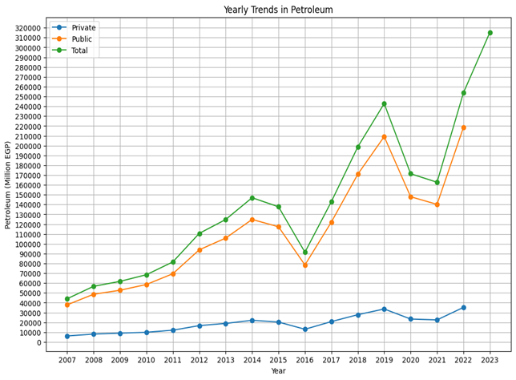
Sector-specific Impact Analysis
05. Petroleum
2011 & 2013 Revolutions:
The ongoing political confusion made work harder and reduced the money made from oil.
Keeping oil facilities safe during protests was tough, leading to less oil being produced and distributed.
Covid-19:
Reducing the worldwide need for oil, affecting safety measures at work, slowing down new investments, and limiting the government's income.
Figure : Petroleum Sector trends through the years in Egypt.

Slide 11
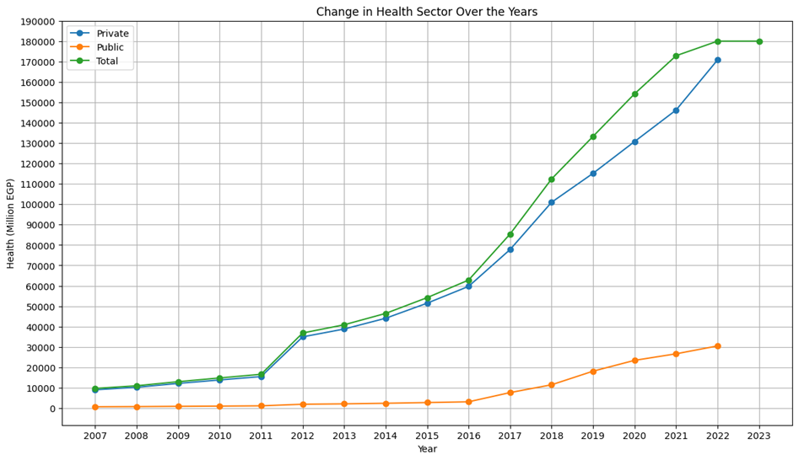
Sector-specific Impact Analysis
06. Health
After 25th January 2011:
In the private sector the change started from 2009 which means the private sector witnessed a change after the 2011 crisis the government started taking care of the public health sector till 2016 which had a significant change.
Covid-19:
The nature of this health crisis leads to higher demand for medical supplies, sanitizers, and related products of chemical industries.
COVID-19 lead to a 30 percent increase in demand for such products.
Figure : Health Sector trends through the years in Egypt.

Slide 12
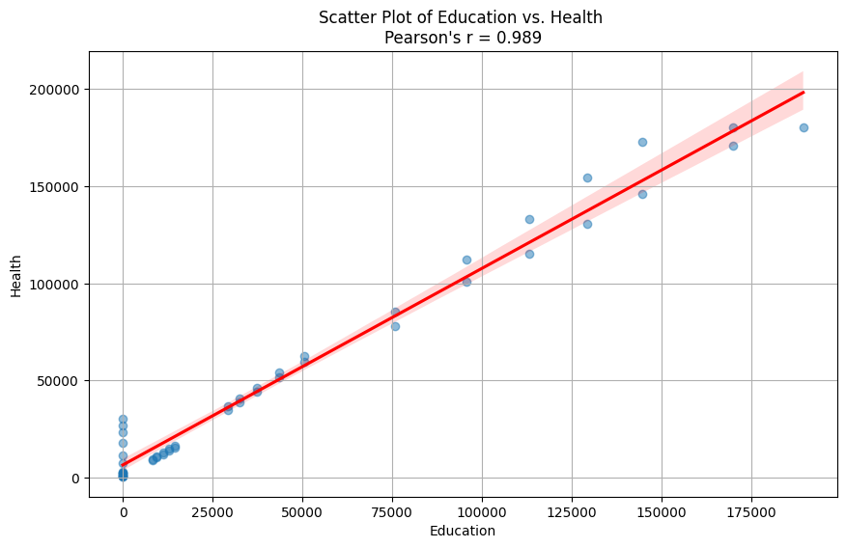
Sector Correlation
Highly Correlated Sectors:
Industries that rely on each other, like those in manufacturing, showed strong correlations.
Similarly, government-funded sectors like education and healthcare, or those with shared infrastructure needs like utilities, all moved in tandem.
The analysis also highlighted the link between financial health and business activities through the correlation between finance and business service sectors.
Correlation between Education and Health Industries = 0.989

Slide 13
Correlation between Education and Health Industries = 0.989

Slide 14
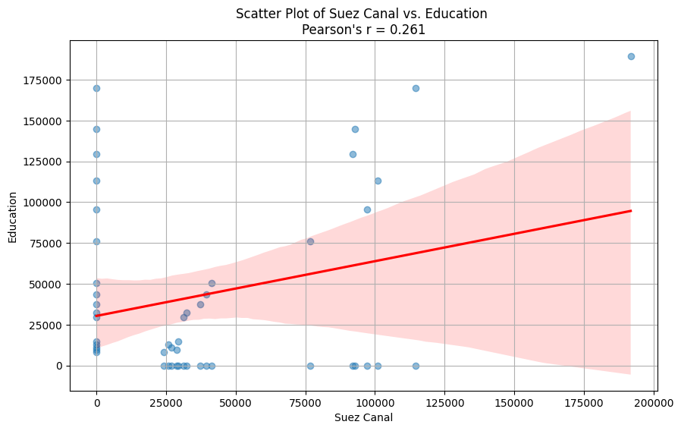
Sector Correlation
Moderate-Low Correlated Sectors
Industries that rely on each other, like those in manufacturing, showed strong correlations.
Similarly, government-funded sectors like education and healthcare, or those with shared infrastructure needs like utilities, all moved in tandem.
The analysis also highlighted the link between financial health and business activities through the correlation between finance and business service sectors.
Correlation between Suez Canal and Education Industries = 0.261

Slide 15
Correlation between Suez Canal and Education Industries = 0.261

Slide 16


Hypothesis Testing
Step 1: Define Ho and H1
Null Hypothesis (H₀): | Alternative Hypothesis (H₁):
There is no association between the occurrence of major upheavals (2011 revolution, 2013 revolution, 2020 pandemic) and the variations in Egypt's Gross Domestic Product (GDP) | There is an association between the occurrence of major upheavals (2011 revolution, 2013 revolution, 2020 pandemic) and the variations in Egypt's Gross Domestic Product (GDP)

Slide 17

Hypothesis Testing
Step 2: Choose the appropriate test.
A chi-squared test for independence was employed to determine whether the observed association between the upheaval events and GDP variations is statistically significant or simply due to chance.
This test is suitable when analyzing categorical variables, such as the presence or absence of an upheaval, and a categorization of GDP variable.

Slide 18

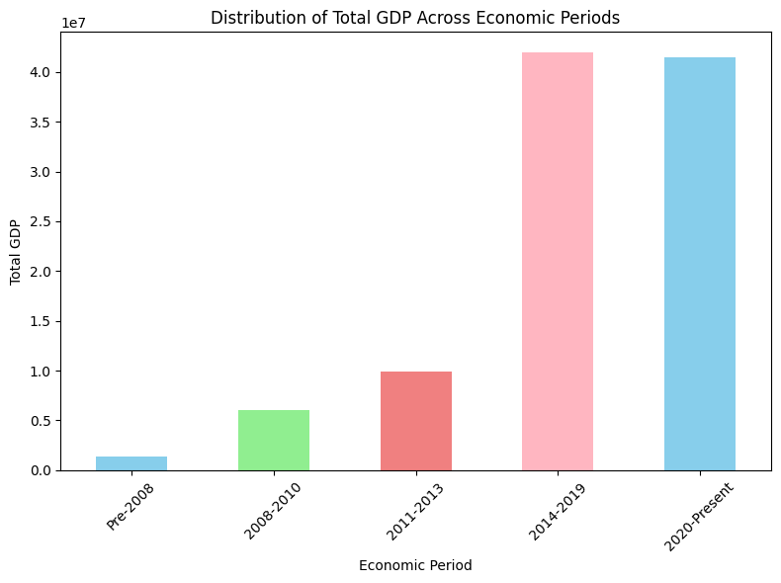
Hypothesis Testing
Step 3: Calculate the p-value.
The chi-squared test yielded a statistically significant p-value of 5.5794647180362105e-05.
This p-value, which is incredibly small, suggests that the likelihood of observing such a strong association between upheavals and GDP changes by chance is extremely low (less than 0.05%).

Slide 19

Hypothesis Testing
Step 4: Determine the statistical significance.
We can reject the null hypothesis, which states that there's no relationship between upheavals and GDP.
This implies that there's a statistically significant association between the chosen upheavals and Egypt's GDP.

Slide 20
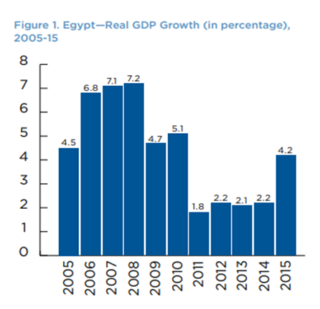
Results
Significant Upheavals vs GDP
Upheavals (wars, civil unrest) typically cause disruptions:
Damage infrastructure, hinder production, and discourage investment.
All of these factors decrease the overall economic activity and GDP
Reduced economic activity leads to lower GDP:
With less production and fewer transactions happening, the total value of goods and services produced in the country (GDP) goes down.

Slide 21
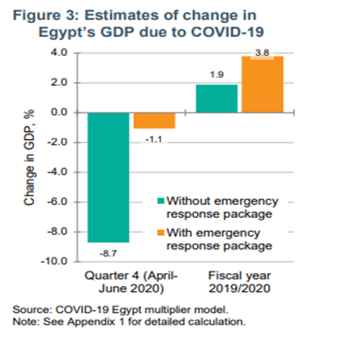
Results
Significant Upheavals vs GDP
Egypt's emergency economic package helped buffer the negative impact of the pandemic on GDP.
Some sectors like agriculture and food processing might have been resilient during the crisis.
They could have indirectly contributed by maintaining food security and potentially replacing imported goods.

Slide 22

Conclusion
This study investigated the link between major upheavals (global and national) and their impact on Egypt's economy.
It focused on three events: 2011 revolution, 2013 revolution, and the 2020 pandemic.
Meticulous sector-wise analysis of each sector that contributed in the GDP with the years of upheaval.
The analysis used a chi-squared test to assess the relationship between upheavals and GDP variations.
The test result (p-value < 0.05) suggests a statistically significant association between upheavals and changes in GDP.
This means it's unlikely to be a coincidence.

Slide 23



Nada Ashraf
Aly Zaki
Manar Yussri
Ahmed Waleed
Omar Bayoumi
Meet our Team

Slide 24
Thank you very much!

